Slide 1



Weather Conditions & Climate Change Analysis for CLimateWINS
Puneet Badwal
November-2025

Slide 2

Introduction & Project Overview
ClimateWins is a European Non-profit Organization that is interested in using machine learning to help predict consequences of climate change in Europe, and potentially the world.
The company has been sorting through a variety of datasets such as the The National Oceanic and Atmospheric Administration (NOAA) in the US, as well as typhoon data from The Japan Meteorogical Agency (JMA), as well as other world temperature datasets.
As a hired data analyst for ClimateWins, it is our job to assess the tools available to categorize and predict the weather in mainland Europe, and use a machine learning model to show what the future holds

Slide 3

hypothesis
One or multiple machine learning algorithms will be able to accurately predict future weather patterns
The weather patterns and behaviors predicted will differ by geographic location as well as other regional conditions specific to that country or area
Overall, temperatures in all the European cities are rising due to moder day global conditions

Slide 4
About the data
Collected by the European Climate Assessment & Dataset Project (ECA&D)
Data Range: 1800s-2022
Weather observations across 18 different weather stations across Europe
Key data variables include temperature, wind speed, snow, global radiation, and much more

Slide 5



Data bias
Data Collection: The way in which the data was collected (especially older data), can be prone to human error or human bias.
Temporal Bias: Since the data is from over 200 years old, current conditions may not be accurately presented by older data (climate change). Collection of all this data over time reduces data accuracy
Data Diversification: Larger areas and regions may be overrepresented in the machine learning models
Notes:
Data Collection: Is each weather station gathering data in the same manner across multiple different European countries, using the same tools. Some things are also subjective (What is “pleasant” weather?)
Temporal Bias : How accurate can the data be from “the 1800s” where tools and measurements are not as accurate as today’s technology? Long term averages may mask recent trends (last 20ish years)
Data diversification bias: Machine learning models might have a bias towards larger regions and underrepresent those smaller European cities/weather stations

Slide 6
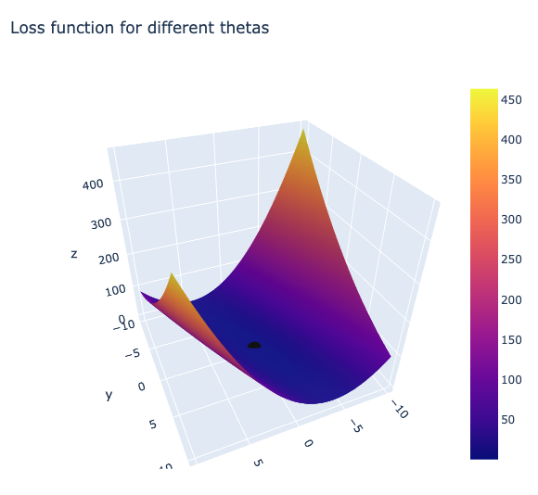
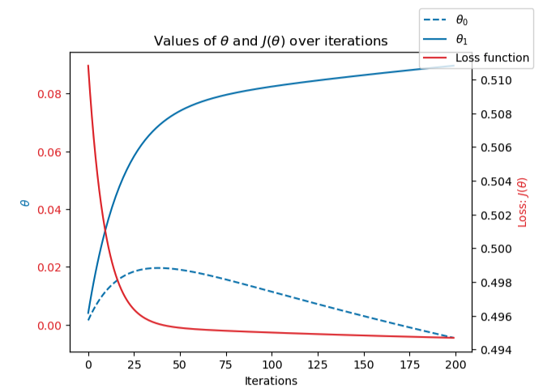
optimization
The data optimization technique used was Gradient Decent across multiple weather stations
Gradient Decent:
  The model continuously adjusts its parameters to reduce error (minimize loss function)
  The model works through iterations to accurately reduce the loss
  Once the model converges to 0, the model is stable and accurate
Notes:
In this example we see the gradient descent technique used on Madrid temperatures in 2020, approaching 0. Indicating the steady and stable learning by the model
This suggests the temperature trends can be modeled

Slide 7
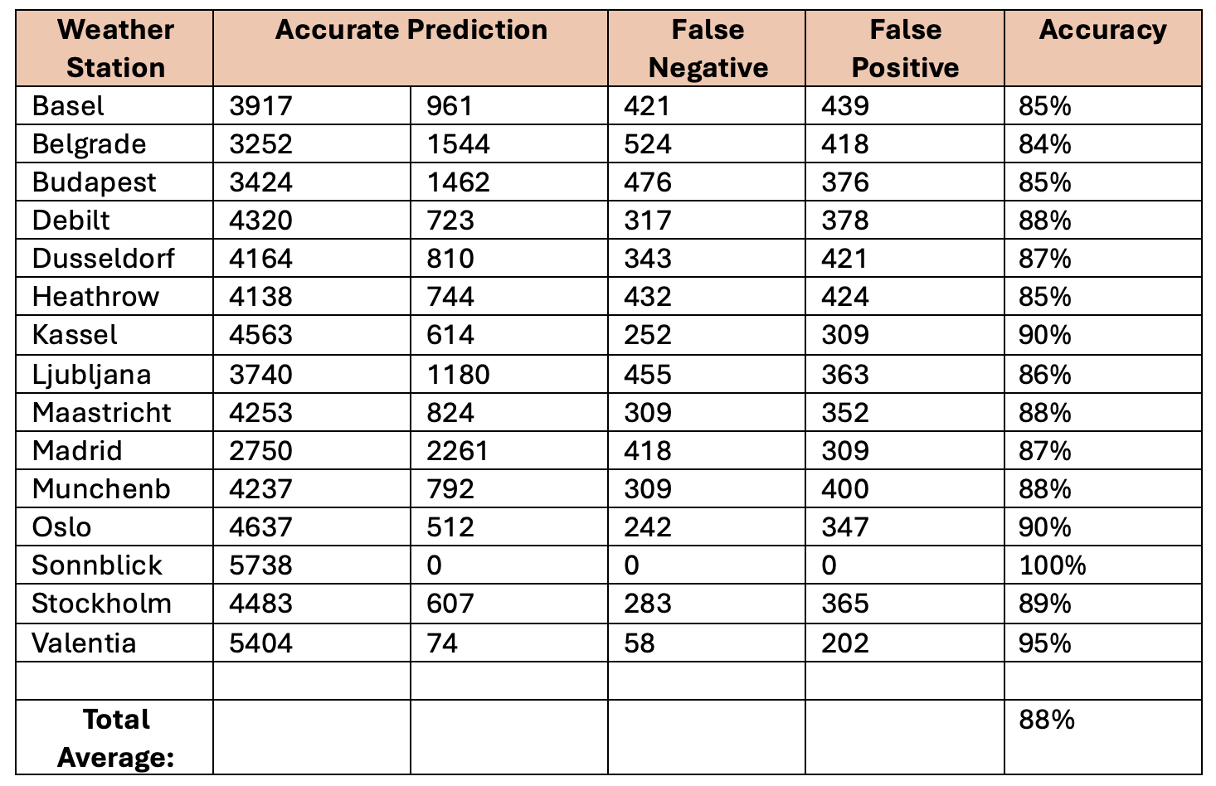
Method 1: KNN Model
The K-Nearest Neighbor (KNN) model predicts outcomes by measuring the distance between new data points and all other data points in the training set.
The table on the right shows the results of the KNN model for all weather stations: Average accuracy 88%
The accuracy of the model can be enhanced with a diverse dataset across a broader range of weather conditions. This may reduce the difference in accuracy across the different weather stations
Model may be overfitting in some cases (Sonnblick)
Notes:
KNN – Nearby data points and are grouped based on number of neighbors in each group
Model showed promising results (Average accuracy of 88% on all weather stations), the best way to enhance the accuracy in future use is to train it with a more diverse dataset that captures a broader range of weather conditions (Not just “pleasant” and “unpleasant” weather). The model is susceptible to overfitting, as you can see in the example of Sonnblick, it hits at an accuracy of 100% when it comes to predicting pleasant weather

Slide 8

Method 2: Decision Tree model
The Decision Tree Model makes predictions by following a sequence of questions based on features of the dataset
The “tree” consists of nodes and branches guiding to new data points according to the best fit
The model produced a training accuracy of 46%, and a testing accuracy of 47%
While the model is simpler in nature than the others, the tree may be too complex with this many branches and nodes for this weather dataset
Notes:
The decision tree was much too complex and not as accurate as the other models. The decision tree model will likely need to undergo pruning for better generalizations and more accurate outcomes.
The confusion matrix for this example also produced a wide variety of numbers of training set vs testing.

Slide 9
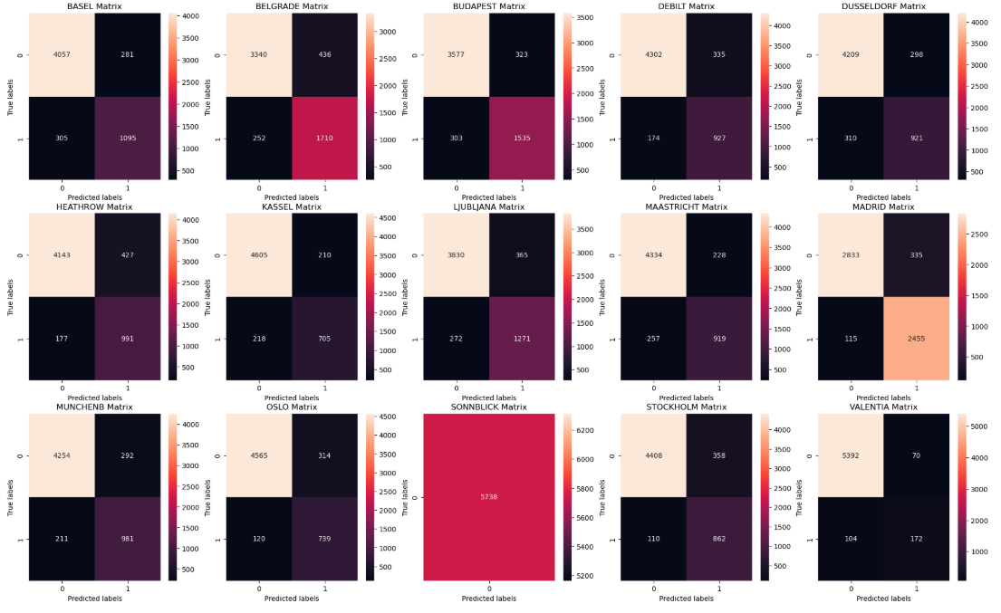
Method 3: ANN model
The Artificial Neural Network (ANN) Model is a computer model that mimics how the human brain processes information – through interconnected layers of neurons that learn patterns and relationships from data training
The ANN model improves by its accuracy predictions by adjusting the strength of the connections based off feedback
The model performance can also be adjusted by tuning the maximum number of iterations, layer sizes, and tolerance
On the left is the confusion matrix displaying the output of the best iteration getting a prediction accuracy of 52% on the testing data

Slide 10
Summary & Recommendations
The model best fit for future use of weather predictions would be the KNN model. The KNN model has the best balance and most reliability, as well as the highest average accuracy across all weather stations.
The decision tree model is not recommended for future use, as the data is not well suited for it. The accuracy tends to falter, and there are too many branches that extended and needs further pruning for effectiveness.
The Artificial Neural Networks Model has the capabilities of producing promising and accurate results. However, at the time, the KNN model is suggested, but can be replaced by the ANN model once there is some fine tuning done with the parameters to improve maximum accuracy.

Slide 11

Next steps
With the correct machine learning in place, the first next step is to expand the data coverage to more stations and regions
Continuously update model with new data
Diversify data points with more/new variables where possible, for increased accuracy
Explore other machine learning models if any additional resources are available
Notes:
Expand to a potential global scale
With an ever changing climate, newer data about climate is crucial to learn more about current global trends
New data with more variables can lead to better accuracy of which countries have pleasant and unpleasant weather
Testing out ANN model with updated parameters or other machine learning techniques like random forests

Slide 12



Thank you!
For any questions, please contact me at
badwalpuneet@gmail.com
For more information on this project, please visit the github link below
github – climatewins analysis
Notes:
Thank you for your time,
Please feel free to reach out to me for any more information via email,
Or check out the github repository for all the corresponding data, python scripts, visualizations and more used for this analysis

